Slide 1
Household Electricity and Electrical Safety

Slide 2
Electricity costs
The amount of electricity used in a house is measured in kilowatt hours (kWh)
This is simply the power (in kilowatts) multiplied by the time (in hours).
If the price of electricity is given in per kilowatt hours, multiply the price by the number of kilowatt hours to get the total cost.

Slide 3
Kilowatt hours
Is simply an energy.
E=P*t
To convert from kWh to J, multiply by 3600 000

Slide 4
Fuses
As we all know by now, electrical transport is not 100% efficient. Some energy is always lost as heat.
Fuses are parts of a circuit, designed to melt or break if too much current passes through them.
The current heats up the fuse, melting the wire within.
Once used- must be replaced

Slide 5
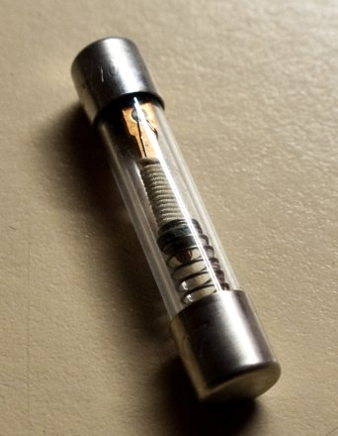
A miniature time-delay 250 V fuse that will interrupt a 0.3 A current at after 100 s, or a 15 A current in 0.1 s. 32 mm (1 1/4") long.

Slide 6
Circuit Breakers
Detects a fault condition- such as too high of a current.
This current either heats up part of the breaker or induces a large enough magnetic field to trip a spring. This spring mechanically opens a switch, breaking the circuit.
Can be reset- does not need to be replaced every time.

Slide 7
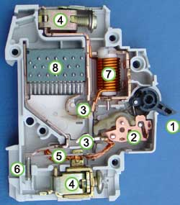
Important bits.
7) Solenoid. Creates a magnet from electricity. More current= stronger magnet
2) Switch mechanism. If magnetic field is strong enough switch opens and breaks circuit.
1) Actuator. Used to reset circuit breaker.

Slide 8
RCDs
Residual current devices. Standard in Australian houses.
Measure the current flowing into a house, as well as current flowing out of the house.
If current in > current out, it triggers, and breaks the circuit.

Slide 9
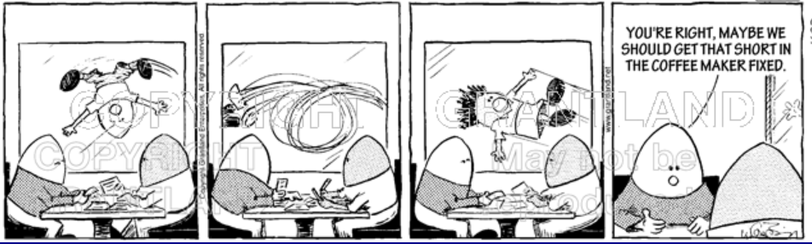
Or install an RCD!

